Slide 1

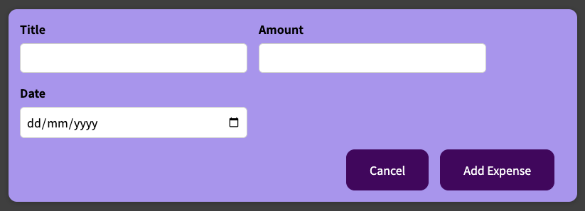
ExpensesMain
New Expense
Component
Data / State
Handler
Add
(expense)
Render
expenses[]
Read
expenseAddHandler
Read
Render
items={expenses}
onAddExpense=
{addExpenseHandler}
items={expenses}
NewExpense
Expenses
(See next slide)
isEditing
saveExpensesHandler
(enteredExpense)
true
false
startEditingHandler
Trigger
stopEditingHandler
Render
! isEdting
isEdting
onClick={startEditingHandler}
onSaveExpenseData={saveExpensesHandler}
onCancel={stopEditingHandler}
[Add New Expense]
ExpenseForm
onClick
Entered
Data
submitHandler
Expense
Data
Read
Read
Render

Slide 2

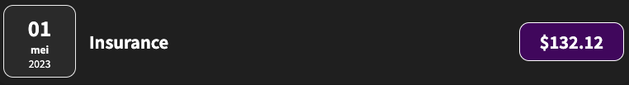
ExpensesMain
Expenses
Component
Data / State
Handler
Add
Render
expenses[]
Read
expenseAddHandler
Read
Render
editExpenseId={editExpenseId}
items={expenses}
View/Edit Expense
Expenses
NewExpense
(see previous slide)
items
write
filteredYear
Read
filterChangeHandler
(selectedYear)
filteredExpenses
Render
selected={filteredYear}
onChangeFilter={filterChangeHandler}
items={filteredExpenses}
items={filteredExpenses}
ExpensesList
ExpensesChart
ExpensesFilter
items
chartDataPoints
onChangeFilter
Render
(items.map (item))
Render
(items.map (item))
dropdownChangeHandler
Key={item.id}
Item={item}
dataPoints={chartDataPoints}
ExpenseItem
Chart
date={item.date}
Value, MaxValue, Label
ChartBar
ExpenseDate

Slide 3
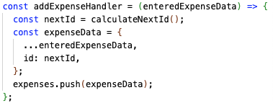
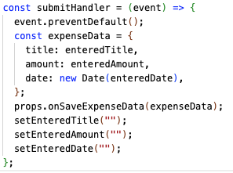

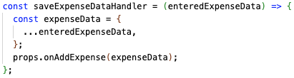


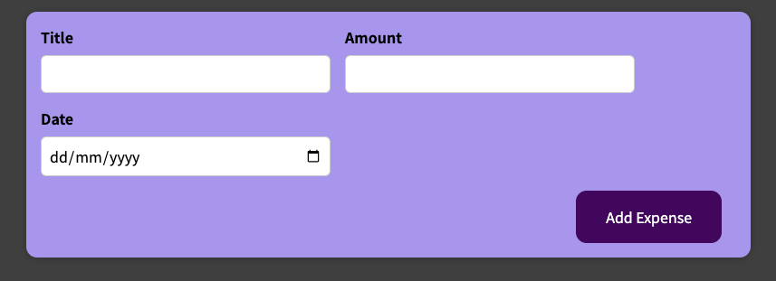
App
NewExpense
ExpenseForm

